Slide 1
Information Systems, Organizations, and Strategy
Chapter 3
VIDEO CASES
  Case 1: National Basketball Association: Competing on Global Delivery with Akamai OS Streaming
  Case 2: IT and Geo-Mapping Help a Small Business Succeed (2009)
  Case 3: Materials Handling Equipment Corp: Enterprise Systems Drive Corporate Strategy for a Small Business
  Instructional Video 1 SAP BusinessOne ERP: From Orders to Final Delivery and Payment

Slide 2
Learning Objectives
Which features of organizations do managers need to know about to build and use information systems successfully?
What is the impact of information systems on organizations?
How do Porter’s competitive forces model, the value chain model, synergies, core competencies, and network economics help companies develop competitive strategies using information systems?
What are the challenges posed by strategic information systems and how should they be addressed?
Notes:
You could ask students to recall some concepts from the previous chapters that might help managers build and use information systems successfully. Answers could include what business processes the company performs, the size of the company, or the organization of the information systems function.

Slide 3
Should T.J. Maxx Sell Online?
Problem: No online presence, powerful competitors, variable inventory
Solutions:
  Develop online sales process
  Experiment with flash sales
Demonstrates IT’s central role in defining competitive strategy

Slide 4
Features of Organizations
Information technology and organizations influence each other
  Relationship influenced by organization’s
    Structure
    Business processes
    Politics
    Culture
    Environment
    Management decisions
Notes:
This concept was briefly discussed in Chapter 1. Figure 1-2 and 1-3 as well as the figure on the next slide, 3-1, display this interdependent relationship graphically.

Slide 5
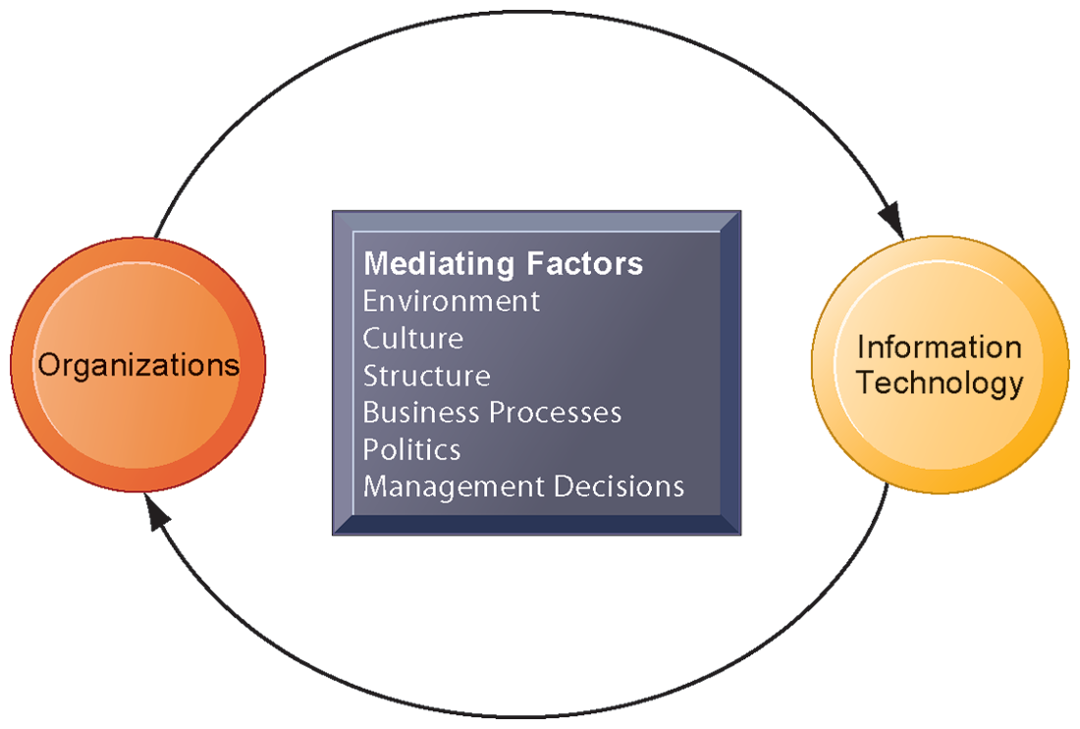
THE TWO-WAY RELATIONSHIP BETWEEN ORGANIZATIONS AND INFORMATION TECHNOLOGY
This complex two-way relationship is mediated by many factors, not the least of which are the decisions made—or not made—by managers. Other factors mediating the relationship include the organizational culture, structure, politics, business processes, and environment.
FIGURE 3-1
Notes:
Ask students to explain how each factor might affect the relationship between organizations and information technology. Emphasize to students that the relationship between these two and its effects on the future of a business are difficult to predict. For example, very few people could have predicted the prominence of e-mail and instant messaging in business communication 15 years ago.

Slide 6
Features of Organizations
What is an organization?
  Technical definition:
    Formal social structure that processes resources from environment to produce outputs
    A formal legal entity with internal rules and procedures, as well as a social structure
  Behavioral definition:
    A collection of rights, privileges, obligations, and responsibilities that is delicately balanced over a period of time through conflict and conflict resolution
Notes:
Which of the two definitions do students find more accurate and why? It is important to consider both definitions rather than exclusively use one at the expense of the other. The two definitions are complementary.

Slide 7
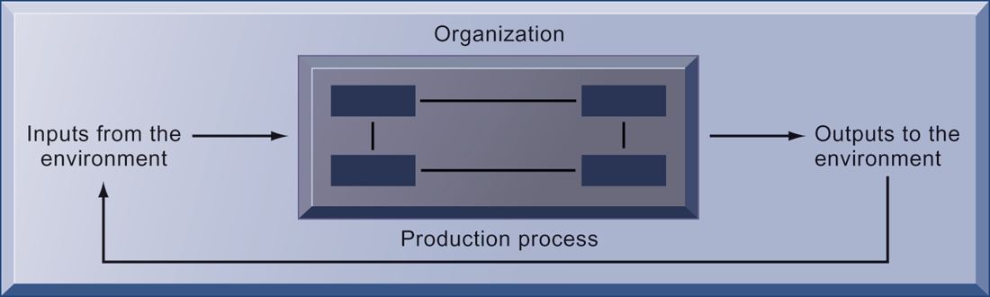
THE TECHNICAL MICROECONOMIC DEFINITION OF THE ORGANIZATION
FIGURE 3-2
In the microeconomic definition of organizations, capital and labor (the primary production factors provided by the environment) are transformed by the firm through the production process into products and services (outputs to the environment). The products and services are consumed by the environment, which supplies additional capital and labor as inputs in the feedback loop.
Notes:
Ask students what are the inputs from the environment? What do organizations output (goods and services). In this view, the organization or business firm is rather easily changed, and malleable. The organization is a collection of parts, like a machine, that can be rearranged as needed. There are no humans in this model, or if there are, they are assumed to be relatively simple.

Slide 8
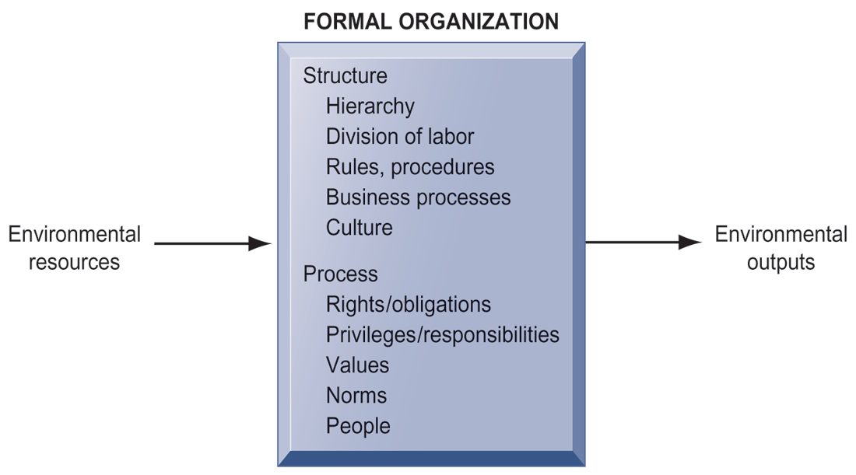
THE BEHAVIORAL VIEW OF ORGANIZATIONS
The behavioral view of organizations emphasizes group relationships, values, and structures.
FIGURE 3-3
Notes:
In this view, the business firm is a little more difficult to change rapidly or on command because it is a very complex machine populated with human beings. Firms operate with an existing hierarchy, job definitions, business rules, legal contracts, procedures, and processes. Efficient organizations become very good at these elements of business. Changing these elements takes more time.

Slide 9
Features of Organizations
Features of organizations
    Use of hierarchical structure
    Accountability, authority in system of impartial decision making
    Adherence to principle of efficiency
    Routines and business processes
    Organizational politics, culture, environments, and structures
Notes:
You could ask students to envision what would happen to an organization that did not use a hierarchical structure (would anything get done?), did not adhere to the principle of efficiency (would they provide any good or service worth using at an affordable price?), and so on.

Slide 10
Features of Organizations
Routines and business processes
  Routines (standard operating procedures)
    Precise rules, procedures, and practices developed to cope with virtually all expected situations
  Business processes: Collections of routines
  Business firm: Collection of business processes
Notes:
You could ask students to describe examples of situations where a business they have interacted with has had a well-understood set of routines. One such example is at the doctor’s office, where the receptionist, nurses, and doctors all have a defined set of routines. Ask students to think about and describe routines they performed on their jobs.

Slide 11
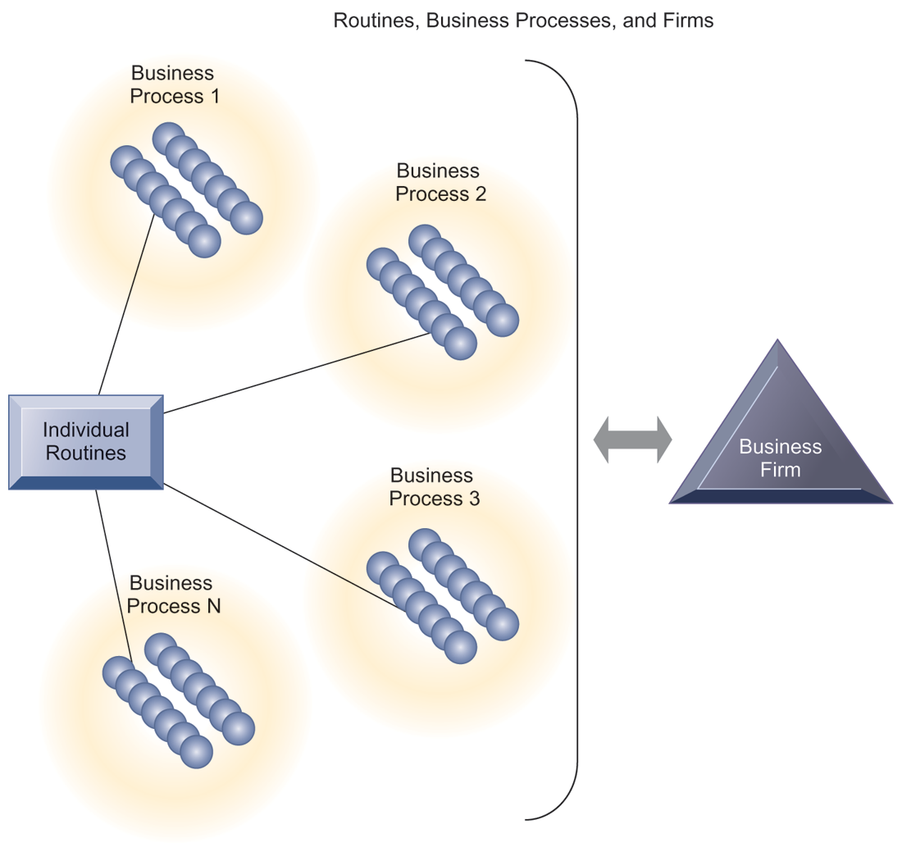
ROUTINES, BUSINESS PROCESSES, AND FIRMS
All organizations are composed of individual routines and behaviors, a collection of which make up a business process. A collection of business processes make up the business firm. New information system applications require that individual routines and business processes change to achieve high levels of organizational performance.
FIGURE 3-4
Notes:
Explain to students that the blue spheres are individual routines, which together constitute a business process. A firm can be seen as a collection of these processes.

Slide 12
Features of Organizations
Organizational politics:
  Divergent viewpoints lead to political struggle, competition, and conflict.
  Political resistance greatly hampers organizational change.
Notes:
You could ask students to describe examples where organizational politics might hamper a firm’s ability to succeed, or examples where effectively managed organizational politics helps a company to undergo a smoother transition or make more intelligent decisions. Ask students to describe their personal experiences with “organizational politics.”

Slide 13
Features of Organizations
Organizational culture:
  Encompasses set of assumptions that define goal and product
    What products the organization should produce
    How and where it should be produced
    For whom the products should be produced
  May be powerful unifying force as well as restraint on change
Notes:
Culture may seem like a pretty abstract idea to many students. On the other hand, students with work experiences will easily be able to describe the cultures of firms where they have worked. Ask students to describe organizational cultures they have experienced while on the job, or other areas of their lives. What kind of organizational culture do students prefer and why? Ask students to describe different kinds of cultures and what types of firms are more likely to have them.

Slide 14
Features of Organizations
Organizational environments:
  Organizations and environments have a reciprocal relationship.
  Organizations are open to, and dependent on, the social and physical environment.
  Organizations can influence their environments.
  Environments generally change faster than organizations.
  Information systems can be instrument of environmental scanning, act as a lens.
Notes:
Explain that environmental scanning involves searching for and determining external changes that may require an organizational response. The current economic climate represents an example of external change that requires sweeping organizational responses to ensure survival.

Slide 15
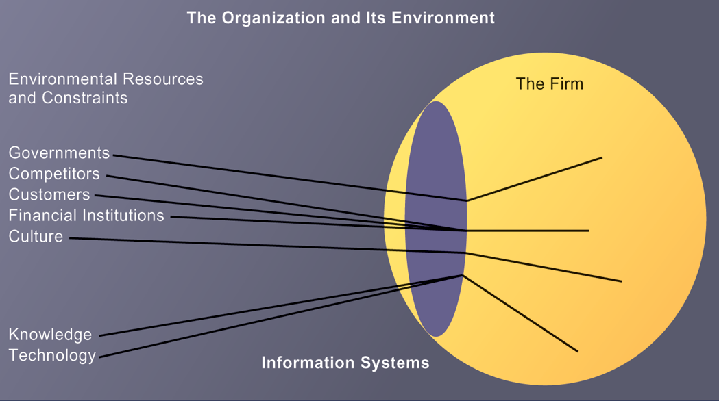
ENVIRONMENTS AND ORGANIZATIONS HAVE A RECIPROCAL RELATIONSHIP
FIGURE 3-5
Environments shape what organizations can do, but organizations can influence their environments and decide to change environments altogether. Information technology plays a critical role in helping organizations perceive environmental change and in helping organizations act on their environment.
Notes:
This graphic further establishes information systems as the “lens” of the firm, observing external factors and filtering information back in to the firm. To some extent, organizations “see” only what their systems will let them see. If systems are poorly built, they may blind managers to difficulties and problems.

Slide 16
Features of Organizations
Disruptive technologies
  Technology that brings about sweeping change to businesses, industries, markets
  Examples: personal computers, word processing software, the Internet, the PageRank algorithm
  First movers and fast followers
    First movers—inventors of disruptive technologies
    Fast followers—firms with the size and resources to capitalize on that technology
Notes:
Ensure that students understand that the PageRank algorithm is the underlying technology behind Google search. Ask students if they can give examples of any first movers that invented a disruptive technology, yet failed to last (examples might include the Altair personal computer, the Netscape Navigator Internet browser, etc.).

Slide 17
Features of Organizations
Five basic kinds of organizational structure
  Entrepreneurial:
    Small start-up business
  Machine bureaucracy:
    Midsize manufacturing firm
  Divisionalized bureaucracy:
    Fortune 500 firms
  Professional bureaucracy:
    Law firms, school systems, hospitals
  Adhocracy:
    Consulting firms
Notes:
Do students agree with the classification of these types of organizational structure? Can they come up with examples for each type of organization?

Slide 18
Features of Organizations
Other organizational features
  Goals
    Coercive, utilitarian, normative, and so on
  Constituencies
  Leadership styles
  Tasks
  Surrounding environments
Notes:
Ask students to give some examples of each organizational feature listed above. For example, different organizations (prisons, businesses, colleges) have different types of goals (coercive, utilitarian, normative, respectively).

Slide 19
The Impact of Information Systems on Organizations
Economic impacts
  IT changes relative costs of capital and the costs of information.
  Information systems technology is a factor of production, like capital and labor.
  IT affects the cost and quality of information and changes economics of information.
    Information technology helps firms contract in size because it can reduce transaction costs (the cost of participating in markets)
      Outsourcing
Notes:
IT figures to replace the function of more middle managers as time passes, as well as reduce the need for other forms of capital (buildings, machinery). Ensure that students understand what is meant by “economics of information” and why outsourcing is a possibility due to IT.

Slide 20
The Impact of Information Systems on Organizations
Transaction cost theory
  Firms seek to economize on transaction costs (the costs of participating in markets).
    Vertical integration, hiring more employees, buying suppliers and distributors
  IT lowers market transaction costs for firm, making it worthwhile for firms to transact with other firms rather than grow the number of employees.
Notes:
Explain that using the market can be expensive. If you depend on the market, rather than hiring employees, you will need to search for talent, research the quality of providers and workers, write contracts for work to be performed, monitor the work, and so forth. When participation in markets is expensive, firms would rather hire employees to accomplish their work. But the Internet makes it less expensive to use the marketplace. With the Internet, firms find it more cost effective to use the marketplace and contract for work in a market, rather than hire employees. Ask your students why the Internet can make participating in markets less expensive than before.

Slide 21
The Impact of Information Systems on Organizations
Agency theory:
  Firm is nexus of contracts among self-interested parties requiring supervision.
  Firms experience agency costs (the cost of managing and supervising) which rise as firm grows.
  IT can reduce agency costs, making it possible for firms to grow without adding to the costs of supervising, and without adding employees.
Notes:
By characterizing employees as independent agents requiring constant supervision, agency theory underscores a key reason that costs increase as firms grow in size and scope—the need to expend more effort managing their employees.

Slide 22
The Impact of Information Systems on Organizations
Organizational and behavioral impacts
  IT flattens organizations
    Decision making is pushed to lower levels.
    Fewer managers are needed (IT enables faster decision making and increases span of control).
  Postindustrial organizations
    Organizations flatten because in postindustrial societies, authority increasingly relies on knowledge and competence rather than formal positions.
Notes:
Ask students to explain what is meant by authority relying on knowledge and competence rather than formal positions. Why might this “flatten” the organization? The idea here is that with sufficient IT, competent workers will be able to accomplish more on their own than they would under a more hierarchical arrangement.

Slide 23
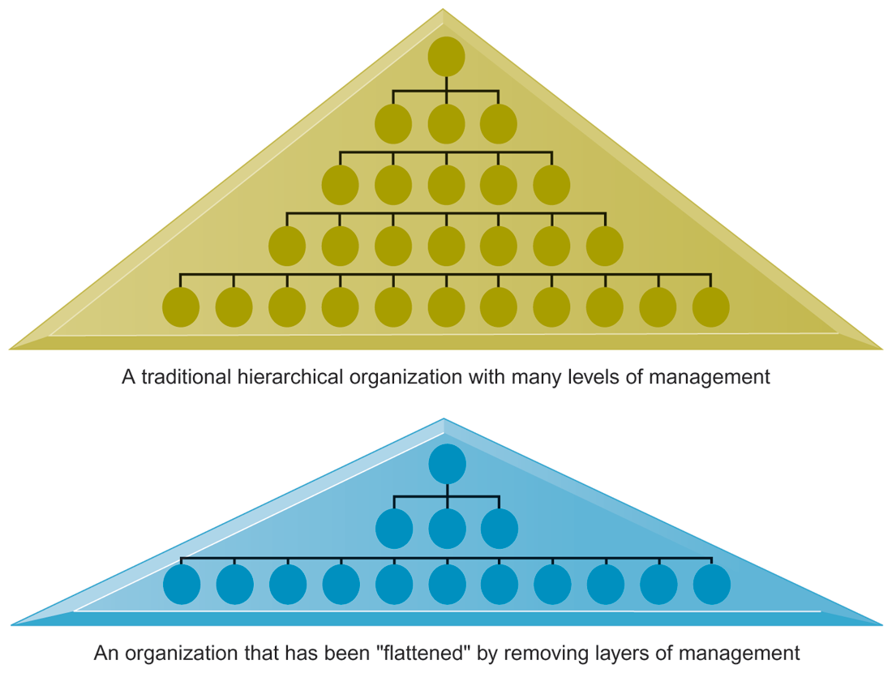
FLATTENING ORGANIZATIONS
Information systems can reduce the number of levels in an organization by providing managers with information to supervise larger numbers of workers and by giving lower-level employees more decision-making authority.
FIGURE 3-6
Notes:
Ask students to explain some of the benefits of the flattened organization as opposed to the more complicated hierarchy in the top of the diagram. Information travels through fewer levels to its intended recipients; there are fewer managers, so agency costs are smaller, and firms can act faster (less decision delay).

Slide 24
The Impact of Information Systems on Organizations
Organizational resistance to change
  Information systems become bound up in organizational politics because they influence access to a key resource—information.
  Information systems potentially change an organization’s structure, culture, politics, and work.
  Most common reason for failure of large projects is due to organizational and political resistance to change.
Notes:
Explain what is meant by changes in culture and politics of the firm. For example, workers may resist changes that disrupt their routines. Also explain to students that as important as technical understanding of information systems may be for potential managers, it is equally important to understand the people and organizational structures and customs affected by information systems.

Slide 25
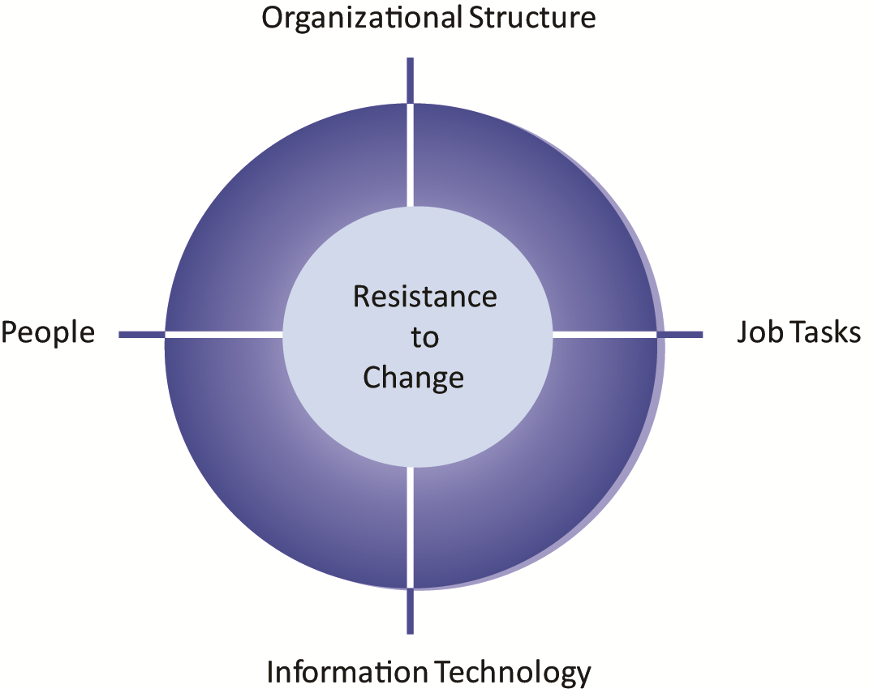
ORGANIZATIONAL RESISTANCE TO
INFORMATION SYSTEM INNOVATIONS
Implementing information systems has consequences for task arrangements, structures, and people. According to this model, to implement change, all four components must be changed simultaneously.
FIGURE 3-7
Notes:
The circle shape in the figure represents the mutual relationship among the concepts shown.

Slide 26
The Impact of Information Systems on Organizations
The Internet and organizations
  The Internet increases the accessibility, storage, and distribution of information and knowledge for organizations.
  The Internet can greatly lower transaction and agency costs.
    Example: Large firm delivers internal manuals to employees via a corporate Web site, saving millions of dollars in distribution costs
Notes:
The Internet should also have a flattening effect on many organizations. Can students describe any businesses that have become more efficient and flat thanks to successful incorporation of the Internet in their operations? Some older students may remember the “bad old days” when seven or more levels of management needed to decide even simple issues in a typical firm. Many Fortune 1000 firms are still like this.

Slide 27
The Impact of Information Systems on Organizations
Organizational factors in planning a new system:
  Environment
  Structure
    Hierarchy, specialization, routines, business processes
  Culture and politics
  Type of organization and style of leadership
  Main interest groups affected by system; attitudes of end users
  Tasks, decisions, and business processes the system will assist
Notes:
Ask students to consider the results of an information system implemented without properly considering each of the above factors. For example, an information system designed without an understanding of the company’s culture and politics is likely to be unpopular, perhaps forcing employees to drastically deviate from their previous routines.

Slide 28
Using Information Systems to Develop Competitive Strategies
Why do some firms become leaders in their industry?
Michael Porter’s competitive forces model
  Provides general view of firm, its competitors, and environment
  Five competitive forces shape fate of firm:
    Traditional competitors
    New market entrants
    Substitute products and services
    Customers
    Suppliers
Notes:
Porter’s competitive forces model is intended to explain why some firms do better than others. Do students believe that this model captures this idea effectively? Which factor is most important to a firm’s success? You can make a list of five well-known firms on the blackboard or screen and ask students, for each firm, which do they think are the most important competitive forces.

Slide 29
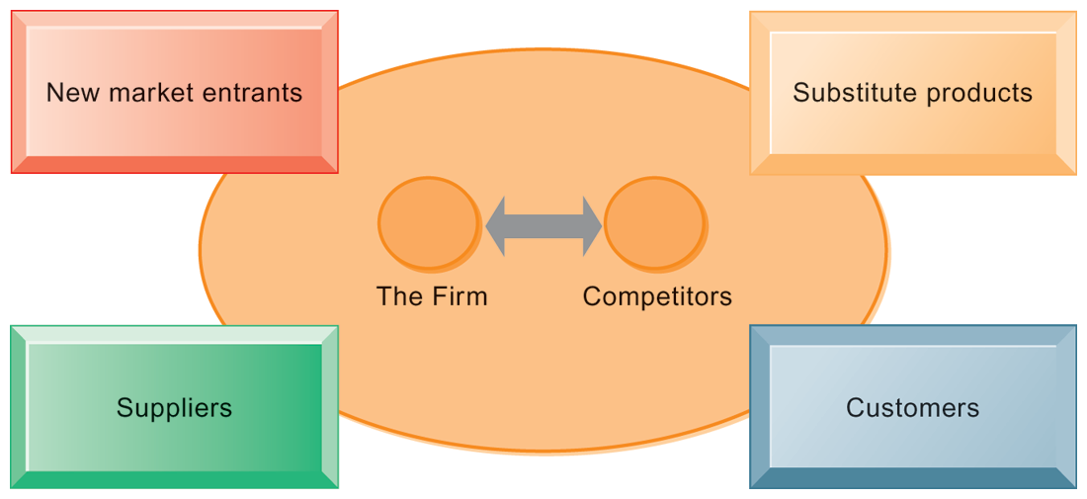
PORTER’S COMPETITIVE FORCES MODEL
FIGURE 3-8
In Porter’s competitive forces model, the strategic position of the firm and its strategies are determined not only by competition with its traditional direct competitors but also by four other forces in the industry’s environment: new market entrants, substitute products, customers, and suppliers.
Notes:
Notice that in the graphic, competitors are represented differently than the other four competitive forces influencing a firm. Why do students think this is the case? One answer might be that competitors are firms in the same industry and are under similar pressures as other firms in the industry.

Slide 30
Using Information Systems to Develop Competitive Strategies
Traditional competitors
  All firms share market space with competitors who are continuously devising new products, services, efficiencies, and switching costs.
New market entrants
  Some industries have high barriers to entry, for example, computer chip business.
  New companies have new equipment, younger workers, but little brand recognition.
Notes:
Ask students to name different industries and describe the benefits and drawbacks of being a new market entrant in each industry.

Slide 31
Using Information Systems to Develop Competitive Strategies
Substitute products and services
  Substitutes customers might use if your prices become too high, for example, iTunes substitutes for CDs
Customers
  Can customers easily switch to competitor's products? Can they force businesses to compete on price alone in transparent marketplace?
Suppliers
  Market power of suppliers when firm cannot raise prices as fast as suppliers
Notes:
Ask students to name different businesses and describe whether or not customers have great control over the business or vice versa, or whether substitute products are a large or insignificant threat to the success of the business.

Slide 32
Using Information Systems to Develop Competitive Strategies
Four generic strategies for dealing with competitive forces, enabled by using IT:
  Low-cost leadership
  Product differentiation
  Focus on market niche
  Strengthen customer and supplier intimacy
Notes:
Here you can make a list of five well-known firms and then analyze with students the major thrust of their strategy. Walmart is a good example to start with because of its emphasis on low-cost leadership.

Slide 33
Using Information Systems to Develop Competitive Strategies
Low-cost leadership
  Produce products and services at a lower price than competitors
  Example: Walmart’s efficient customer response system
Product differentiation
  Enable new products or services, greatly change customer convenience and experience
  Example: Google, Nike, Apple
  Mass customization
Notes:
Do students believe it is possible both to design information systems that focus both on low-cost leadership and product differentiation? Some may say it is with sufficient planning and innovation; perhaps a new product is even cheaper to produce than older ones. Some may say that the investment in innovation required for product differentiation precludes that firm from maintaining low-cost leadership.

Slide 34
Nike Becomes a Technology Company
Evaluate Nike using the competitive forces and value chain models.
What competitive strategies is Nike pursuing? How is information technology related to these strategies?
In what sense is Nike a “technology company”? Explain your answer.
How much of an edge does Nike have over its competitors? Explain your answer.

Slide 35
Using Information Systems to Develop Competitive Strategies
Focus on market niche
  Use information systems to enable a focused strategy on a single market niche; specialize
  Example: Hilton Hotels’ OnQ system
Strengthen customer and supplier intimacy
  Use information systems to develop strong ties and loyalty with customers and suppliers
  Increase switching costs
  Example: Netflix, Amazon
Notes:
You could ask students to provide other examples from their own experience of companies that exemplify strong focus on market niche as well as excellent customer and supplier intimacy.

Slide 36
Identifying Market Niches in the Age of Big Data
Describe the kinds of data being analyzed by the companies in this case.
How is this fine-grained data analysis improving operations and decision making in the companies described in this case? What business strategies are being supported?
Are there any disadvantages to mining customer data? Explain your answer.
How do you feel about airlines mining your inflight data? Is this any different from companies mining your credit card purchases or Web surfing?

Slide 37
Using Information Systems to Develop Competitive Strategies
The Internet’s impact on competitive advantage
  Transformation or threat to some industries
    Examples: travel agency, printed encyclopedia, media
  Competitive forces still at work, but rivalry more intense
  Universal standards allow new rivals, entrants to market
  New opportunities for building brands and loyal customer bases
Notes:
Do students believe it is easier or harder to gain a competitive advantage via the Internet as opposed to more traditional means? Table 3-5 describes the impact of the Internet on various competitive forces.

Slide 38
Using Information Systems to Develop Competitive Strategies
Value chain model
  Firm as series of activities that add value to products or services
  Highlights activities where competitive strategies can best be applied
    Primary activities vs. support activities
  At each stage, determine how information systems can improve operational efficiency and improve customer and supplier intimacy
  Utilize benchmarking, industry best practices
Notes:
How does the value chain model differ from the Porter model? (It offers more specific detail about what exactly to do to achieve competitive advantages.) How do primary activities differ from support activities?

Slide 39
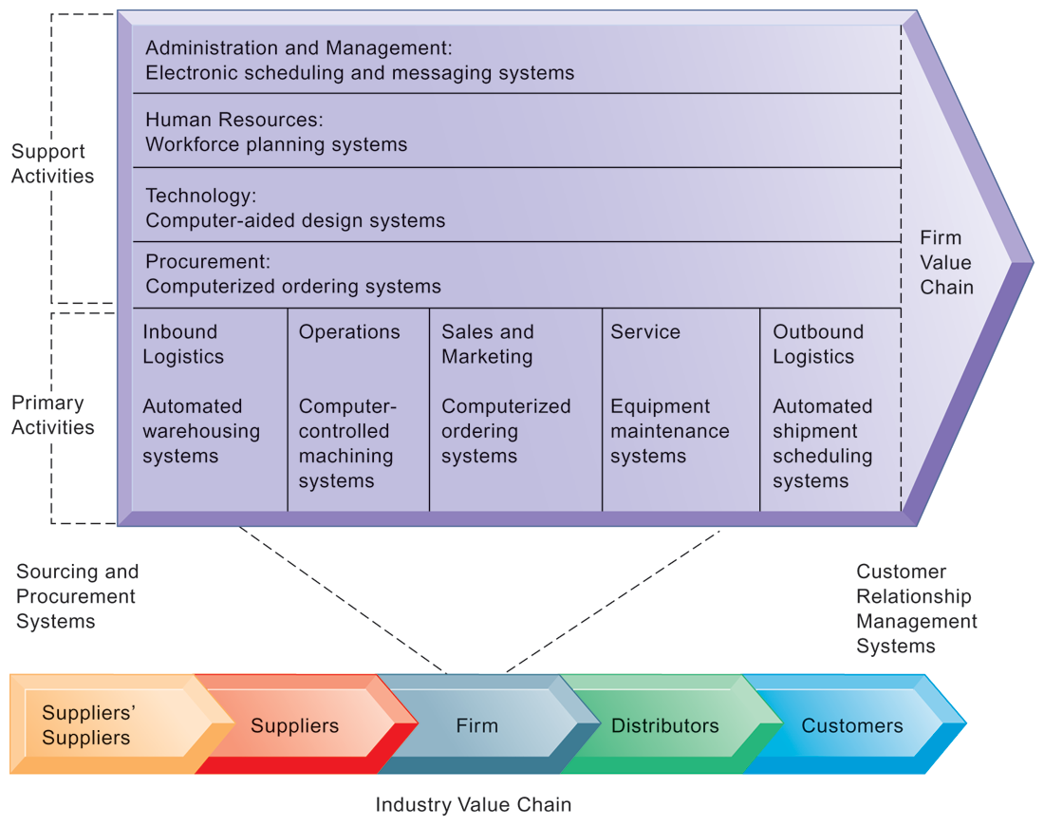
THE VALUE CHAIN MODEL
This figure provides examples of systems for both primary and support activities of a firm and of its value partners that can add a margin of value to a firm's products or services.
FIGURE 3-9
Notes:
Emphasize the relationship between the primary and support activities of this firm and explain how information systems are critical to the success of each activity.

Slide 40
Using Information Systems to Develop Competitive Strategies
Value web:
  Collection of independent firms using highly synchronized IT to coordinate value chains to produce product or service collectively
  More customer driven, less linear operation than traditional value chain
Notes:
Explain that a value web extends beyond the boundaries of an individual firm and represents the coordination of value chains across multiple independent firms. A value web is flexible and adapts to changes in supply and demand and changing market conditions.

Slide 41
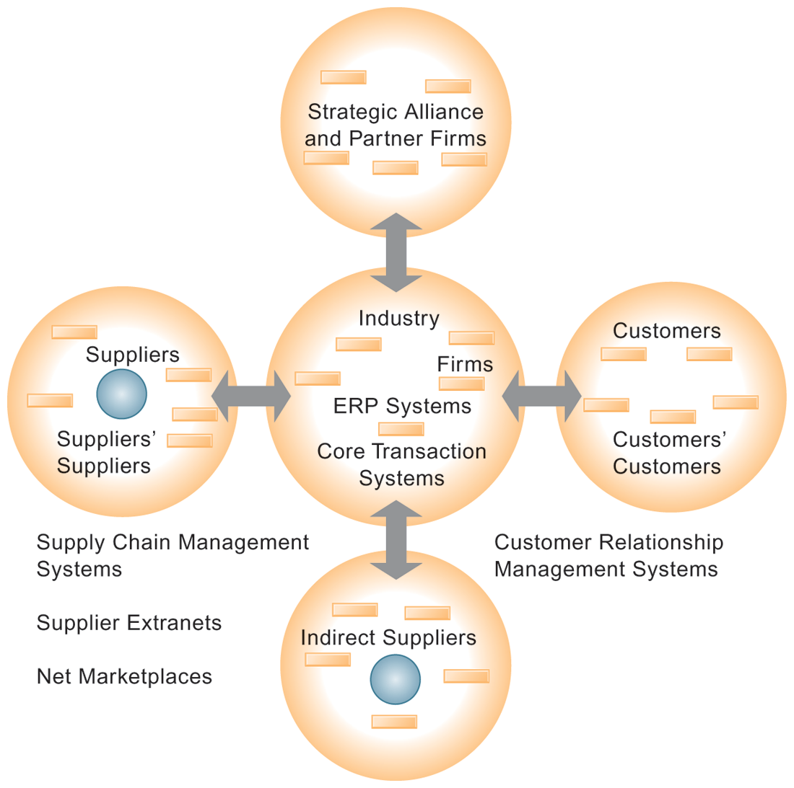
THE VALUE WEB
The value web is a networked system that can synchronize the value chains of business partners within an industry to respond rapidly to changes in supply and demand.
FIGURE 3-10
Notes:
Ask students why a model like the one displayed in the figure might be more likely to adapt quickly to changes in supply and demand. Also emphasize the networking among the different segments of the value web.

Slide 42
Using Information Systems to Develop Competitive Strategies
Information systems can improve overall performance of business units by promoting synergies and core competencies
  Synergies
    When output of some units used as inputs to others, or organizations pool markets and expertise
    Example: merger of Bank of NY and JPMorgan Chase
    Purchase of YouTube by Google
Notes:
Explain that information technology’s role in promoting synergy is often tying together operations of disparate business units so that they can act as a whole. Why might this lead to reduced costs and increased efficiency?

Slide 43
Using Information Systems to Develop Competitive Strategies
Core competencies
  Activity for which firm is world-class leader
  Relies on knowledge, experience, and sharing this across business units
  Example: Procter & Gamble’s intranet and directory of subject matter experts
Notes:
Can students name any other notable examples of core competencies among firms? (Google: search, Microsoft: office productivity software; Intel processors, and so on)

Slide 44
Using Information Systems to Develop Competitive Strategies
Network-based strategies
  Take advantage of firm’s abilities to network with one another
  Include use of:
    Network economics
    Virtual company model
    Business ecosystems
Notes:
Examples of firms that use this type of strategy to achieve an advantage are eBay and iVillage. Many other companies are following suit in using a network-based strategy—can students name any? eBay, iVillage, and social networking firms such as Facebook, are based on networks of millions of users. These companies have used the Web and Internet communication tools to build communities. The more people who join these communities, the more benefit members receive.

Slide 45
Using Information Systems to Develop Competitive Strategies
Traditional economics: Law of diminishing returns
  The more any given resource is applied to production, the lower the marginal gain in output, until a point is reached where the additional inputs produce no additional outputs
Network economics:
  Marginal cost of adding new participant almost zero, with much greater marginal gain
  Value of community grows with size
  Value of software grows as installed customer base grows
Notes:
Explain the difference between these two schools of economics. What aspect of network economics allows value to continue to increase with the size of the community?

Slide 46
Using Information Systems to Develop Competitive Strategies
Virtual company strategy
  Virtual company uses networks to ally with other companies to create and distribute products without being limited by traditional organizational boundaries or physical locations
  Example: Li & Fung manages production, shipment of garments for major fashion companies, outsourcing all work to more than 7,500 suppliers
Notes:
Explain to students that companies like this are “virtual” because they do not actually own any factories, machines, or other similar infrastructure. Instead, they offer a series of services, aided by information systems and uninhibited by geographical boundaries.

Slide 47
Using Information Systems to Develop Competitive Strategies
Business ecosystems
  Industry sets of firms providing related services and products
    Microsoft platform used by thousands of firms
    Walmart’s order entry and inventory management
  Keystone firms: Dominate ecosystem and create platform used by other firms
  Niche firms: Rely on platform developed by keystone firm
  Individual firms can consider how IT will help them become profitable niche players in larger ecosystems
Notes:
Can students see the similarities between business ecosystems and value webs? Can they appreciate the key difference (that business ecosystems extend across industries as opposed to just firms within the same industry)?

Slide 48
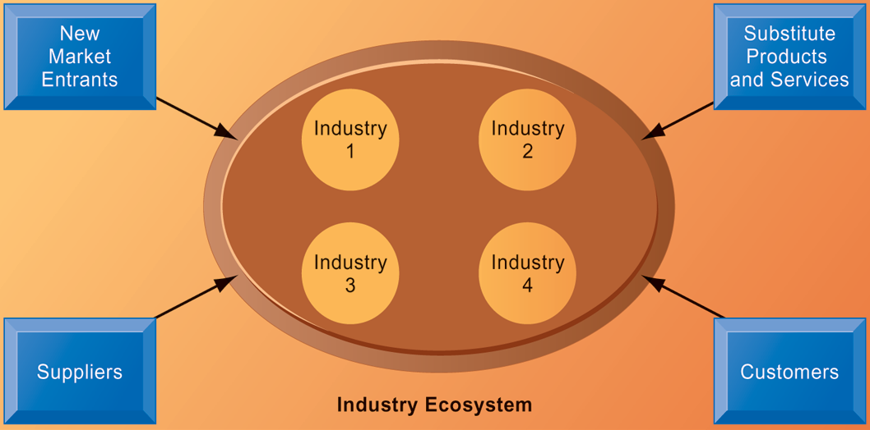
AN ECOSYSTEM STRATEGIC MODEL
FIGURE 3-11
The digital firm era requires a more dynamic view of the boundaries among industries, firms, customers, and suppliers, with competition occurring among industry sets in a business ecosystem. In the ecosystem model, multiple industries work together to deliver value to the customer. IT plays an important role in enabling a dense network of interactions among the participating firms.
Notes:
Emphasize how important IT is in bringing disparate industries together to deliver value to the customer. What are the challenges of coordinating the flow of information across, for example, four different industries, as shown in the figure?

Slide 49
Using Information Systems to Develop Competitive Strategies
Sustaining competitive advantage
  Competitors can retaliate and copy strategic systems
  Systems may become tools for survival
Aligning IT with business objectives
  Performing strategic systems analysis
    Structure of industry
    Firm value chains
Managing strategic transitions
  Adopting strategic systems requires changes in business goals, relationships with customers and suppliers, and business processes
Notes:
Emphasize the importance and difficulty of aligning information technology with the business. What does this phrase mean? It seems pretty simple. Why do so many companies fail at this critical task? Can students think of any other important questions that management should ask about their company before designing their IT systems? What is a solution for the fact that many competitive advantages can be copied? This fact highlights the importance of continuous innovation in order to stay ahead.

